Slide 1
Tech Visionary Assistant (Tech VA) LLM & Application: Real Time Market Research in Tech Industry
Team: Jason Sjafrudin, David Kuo, Mara Chemerinsky
Capstone Advisor: Jonathan Williams

Slide 2



Demand-Supply Imbalance in the $7.5B Tech Market Industry
0%
88%
$7.5B
Supply
Demand
Tech Sector
Largest industry segment for market research
$7.5 billion invested each year in the US
Employment rate for market researchers in tech has not risen
88% of executives in tech struggling to keep pace
Demand

Slide 3
Revolutionize Tech Market Research with Our Cutting Edge LLM
Competitors
?
Public
Sentiment
1
Identify Top Entities in the Tech Industry
2
Analyze Public Sentiments Towards Entities
Trending
3
Fetch and Summarize Key Articles Across Entities
Future Markets
Notes:
what market should i tap into? (could be based on demand or skilled workforce or investment hotspots to easily secure funding, or avoid maybe due to regulatory challenges and compliance requirements).
Analyze sentiments of key entities and provide summaries of related trending articles for market intelligence.
Key entities: organizations, players, locations, and products.

Slide 4
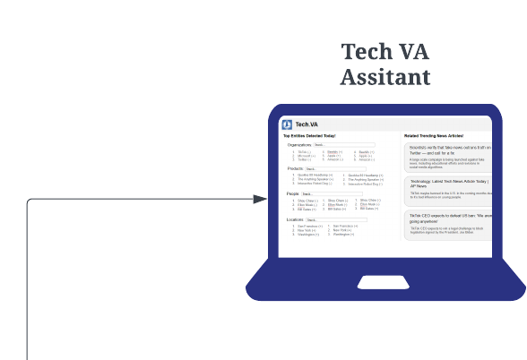
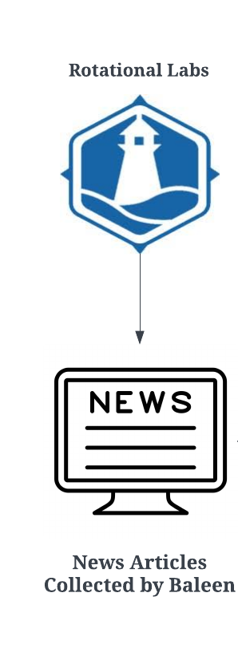
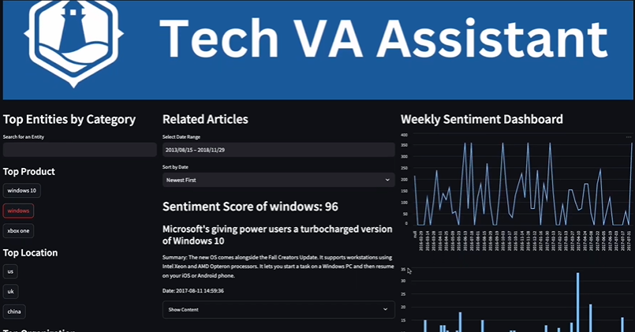

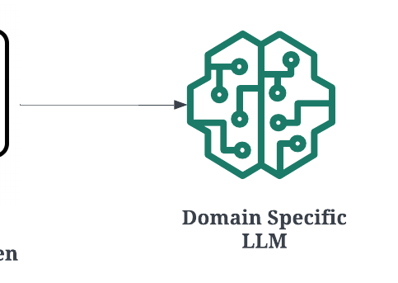
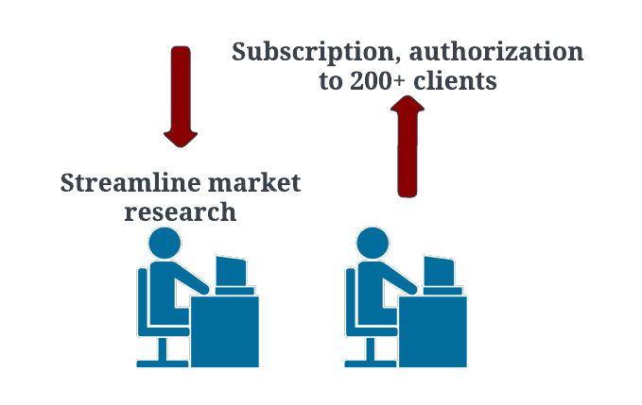
Tech VA Boosts Topline Revenue by $200,000
$200,000
Expected Increase in Rotational Lab’s Annual Revenue
Notes:
Rotational lab already has LLM services toward enterprise users, but they want to utilize their significant collection of textual data collected via Baleen
Rotational Labs is actively seeking ways to incorporate LLM into their existing services and provide stronger and more diverse NLP and machine learning analytics solutions to expand their clientele. Therefore, they are actively seeking user-facing products that can unlock the full potential of their collected textual data with LLM and increase their topline revenue by $200,000.

Slide 5




Meeting Market Researchers' Needs
Praveen Namakkal
Nikasha Patel
Top 8 Key Features Valued by Tech Market Researchers
1
Trending Products & Entities to Invest
5
Real Time Tracking
2
Regional Market Conditions
6
Reliable Insights
3
Powerful Figures for Collaboration
7
10 years experience in Market Research
MIT Graduate Student Researcher
Articles Summarization
8
4
Swiftly Navigating Articles
Time Series Sentiment Analysis
Susie Mullen
Irene Giarto
🙷
🙷
Growing demand for adoption of AI-driven market research tools
This application would’ve slashed our workload by 60%
🙷
🙷
Freelance Market Researcher
Co-Founder at Askpert.id Main Service: Market Research

Slide 6











Unveiling the Unparalleled Edge of Our Solution
One Stop Shop which makes it convenient and effective
Focus on Tech Market to capture domain-specific nuances
Reliable and Credible data source exclusively composed of News Articles for higher accuracy and reliability over social media or forums

Slide 7
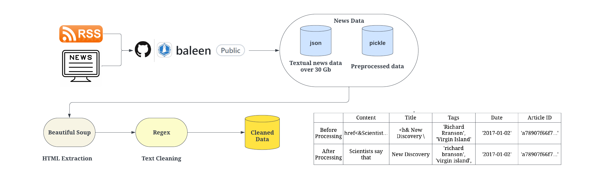
Raw to Refined: Mastering the Art of Cleaning with Our Pipeline
Custom Cleaning Pipeline
Cleaned
Preprocessed
Data
Beautiful Soup
Regex
HTML Extraction
Text Cleaning

Slide 8
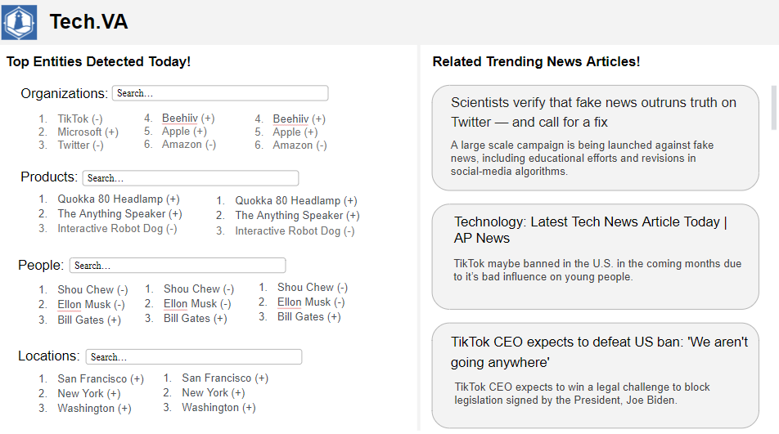
Customizing Intelligence: Our Game Changing Methodology
Cleaned
Preprocessed
Data
Baleen Repo
BART Mechanism
(Tokenization & Vectorization)
Custom Cleaning Pipeline
Unsupervised fine-tuning BART
Preprocessed Data
NER NLP Model- Medium SpaCy Mode
(+ manual supervision)
Sentiment NLP Model- Flair State of the Art NLP Library
(+ manual supervision)
Feature Dataset
Text Summarization
Fine-tuned LLM 1
Fine-tuned LLM 2
Entity Identification
Feature Datasets
Supervised fine-tuning BERT
Fine-tuned LLM 3
Sentiment Analysis
Tech.VA Application
Labeled Dataset
BERT Mechanism
(Tokenization & Vectorization)

Slide 9




Outperforming Existing Benchmarks
Function
Metric
Fine-Tuned LLM
Open-Source LLM
Text Summarization | ROUGE 1 | 0.26 | 0.15 (BART)
 | ROUGE L | 0.25 | 0.14 (BART)
Entity Identification | Precision | 0.69 | 0.33 (BERT)
 | Recall | 0.62 | 0.31 (BERT)
 | F1-Score | 0.65 | 0.32 (BERT)
 | Accuracy | 0.94 | 0.74 (BERT)
Sentiment Analysis | Precision | 0.74 | 0.38 (BERT)
 | Recall | 0.78 | 0.39 (BERT)
 | F1-Score | 0.75 | 0.39 (BERT)
 | Accuracy | 0.83 | 0.61 (BERT)

Slide 10
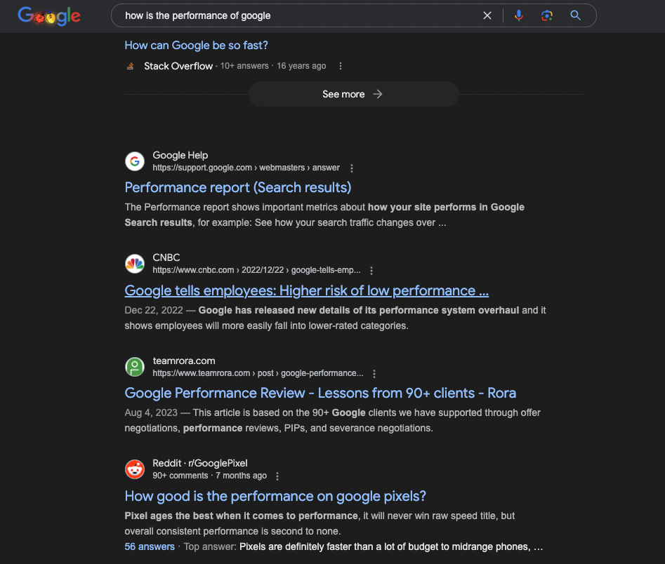
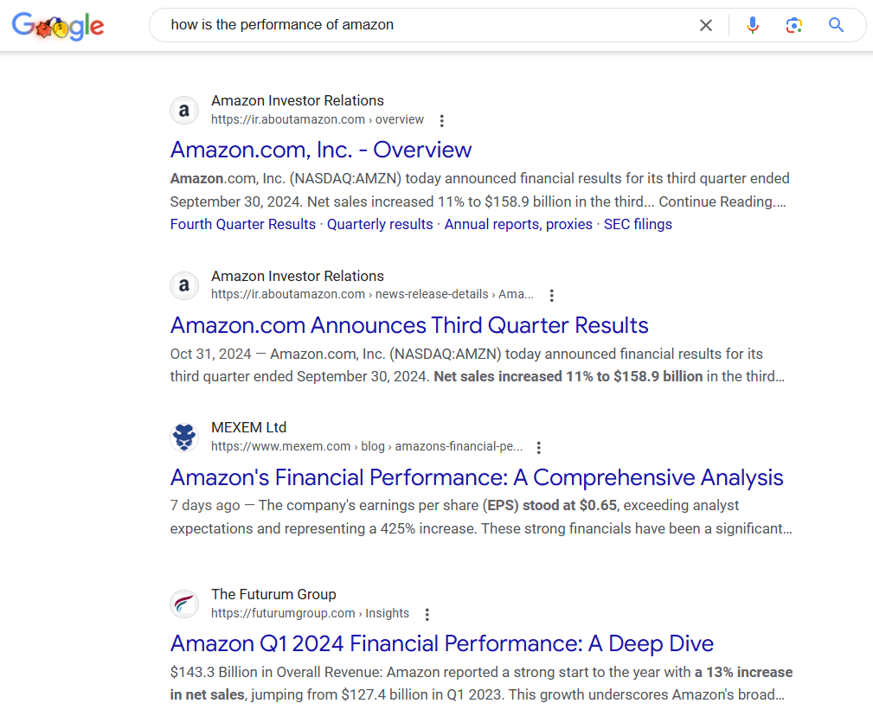
Praveen’s Market Research Struggle
Market Researcher- Praveen Namakkal
Attempting to find the competitive intelligence of Google vs Amazon

Slide 11
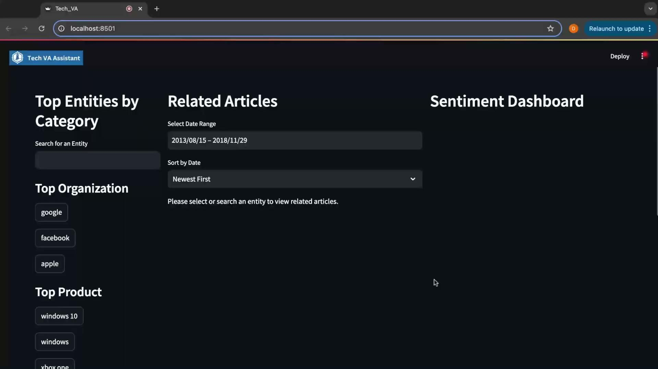
Innovation Showcase: Introducing Tech VA

Slide 12

Streamline Market Research in Your Fingertips
Unlock Insights Faster:
Cross-entity comparison with comprehensive LLM modeling
Save Time, Work Smarter:
Streamline the time-consuming searching and look-up process in a few clicks
Get Started Today:
Visit https://rotational.io/ if you are interested in subscribe to the service!

Slide 13

Thank you - Questions?

